Slide 1
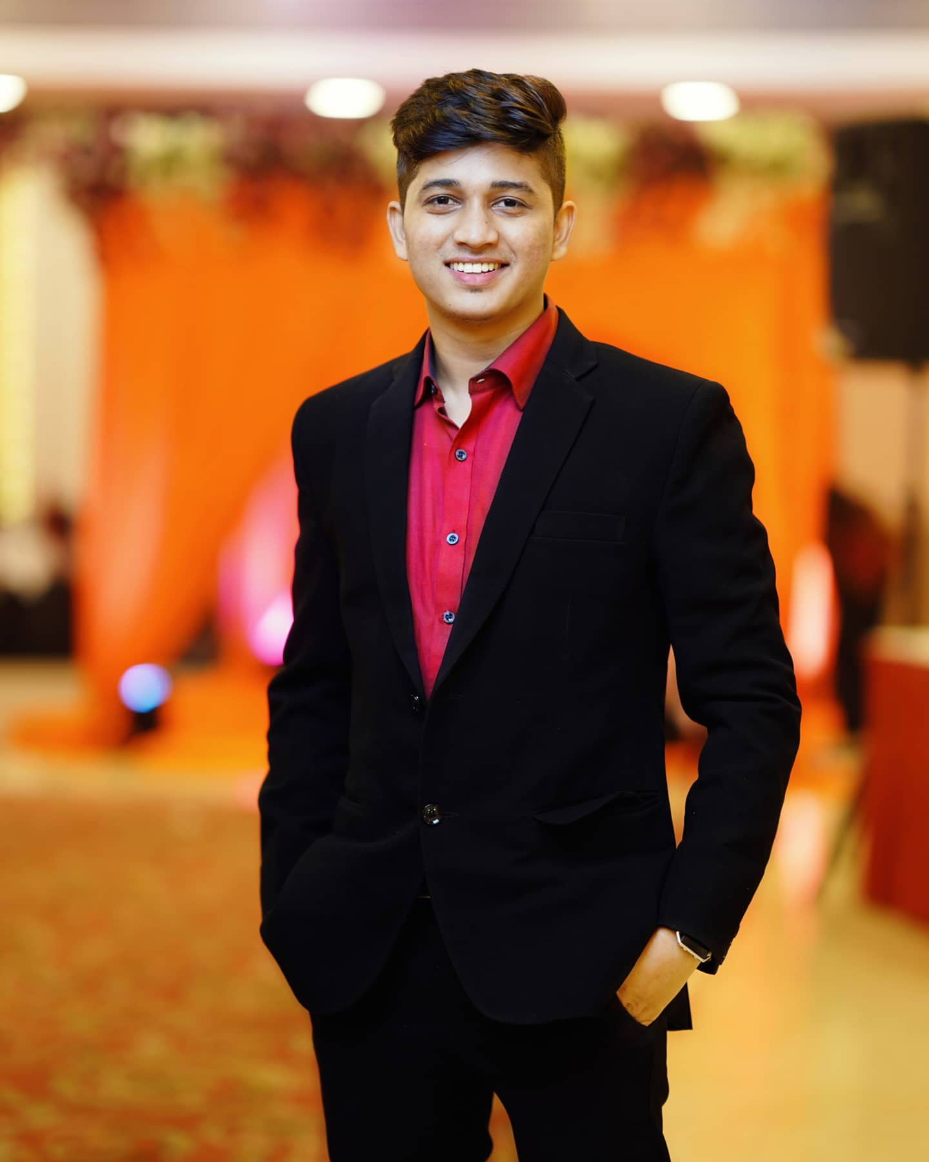

Name: Rushabh Bagde Trainee Software Engineer at Axiom Techguru Nagpur, Maharashtra, India
Introduction :-

